Slide 1



Neural Networks and Deep learning
Group G
Fangqing Xu, Mingwen Yang, Nan Shen

Slide 2
Introduction:
--Goal: --Apply Van Gogh’s style to an ordinary photograph
--Model Used:
--Neural Style Transfer --CycleGAN

Slide 3
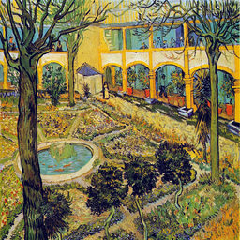
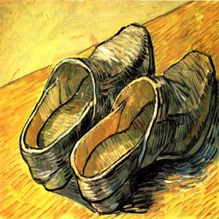
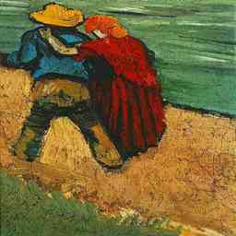
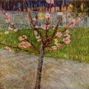
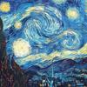

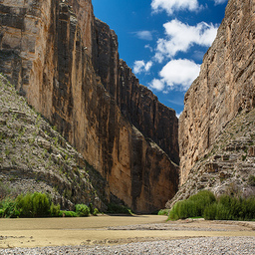
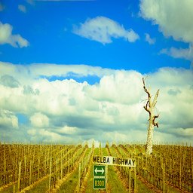
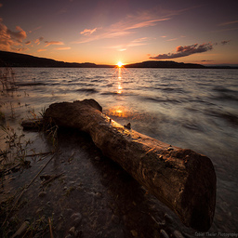

Data description
216 paintings by Van Gogh preprocessed into 128*128
216 landscape paintings preprocessed into 128*128

Slide 4
Basic theory of our products
The algorithm of our model can produce new pictures owning the style of the artists.
The procedures of our model are getting three inputs:
input picture
picture content
picture style
After we get the smallest loss,
we would get the new picture that is most similar to ideal content and style

Slide 5

Theory OF NST
The works of artist is consisted of two essential parts
Content
is what's inside of the picture, like the photos
Style
is how he presents his thoughts and content to others
Human can easily distinguish the style when recognizing the content
Based on neural network, each layer is based on former layer.
Hence, the higher level the reconstruction, the more abstract the output will be.

Slide 6
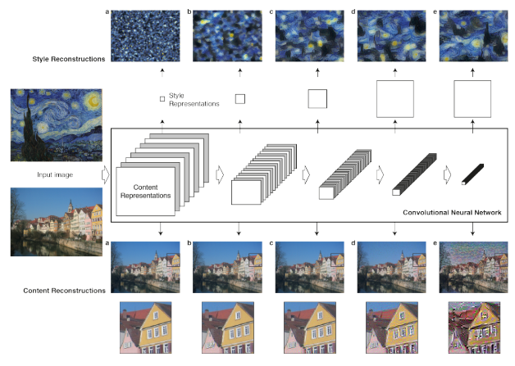
Content Reconstruction
As we see the following pic,
the lower level of the content construction is based on the details of the original pictures.
When we achieve higher level, the picture becomes more abstract
so that it cannot rebuild details.
This is what we want to get
higher level network drop some unnecessary details
it could make people focus more on content of the picture.
So, we could call the characteristic of higher level as content features

Slide 7

How to extract the style ?
Each Filter of the high-level network extracts a feature
different from the content perspective
The style is an author's personalized feature that is independent of the specific content
so it exists in different filters
The extraction style needs to find the common points of different filters.
Specifically, it extracts style features by calculating the correlation of the same layer of Filter

Slide 8
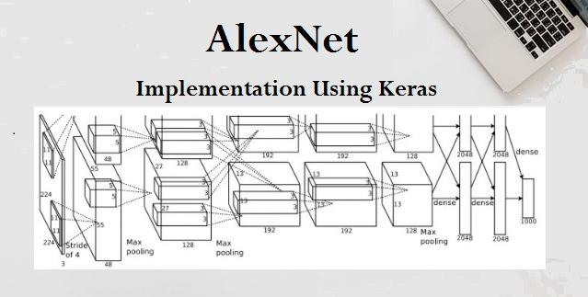
Background
AlexNet came out in 2012
it improved on the traditional Convolutional neural networks
So we can understand VGG as a successor of the AlexNet
but it was created by a different group named as Visual Geometry Group at Oxford’s
Hence the name VGG,
It carries and uses some ideas from it's predecessors
improves on them and uses deep Convolutional neural layers to improve accuracy

Slide 9
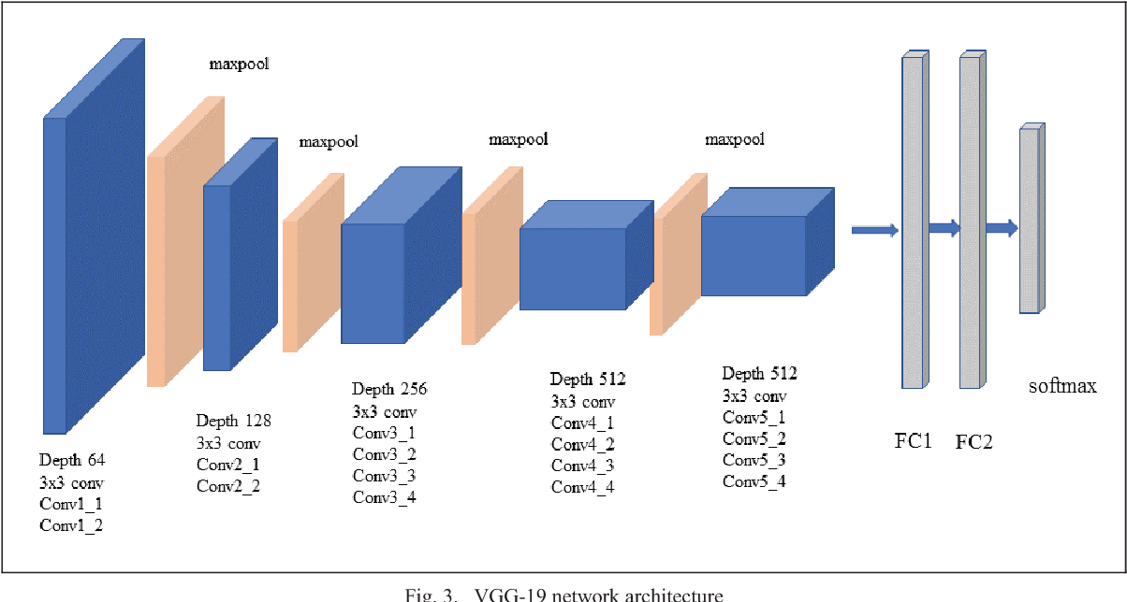
VGG-19
A convolutional neural network
19 layers deep
load a pretrained version of the network
trained on more than a million images from the ImageNet database
Pretrained network
classify images into 1000 object categories
such as keyboard, mouse, pencil, and many animals.
As a result
the network has learned rich feature representations for a wide range of images

Slide 10

Architecture
A fixed size of (224 * 224) RGB image was given as input to this network which means that the matrix was of shape (224,224,3).
The only preprocessing that was done is that they subtracted the mean RGB value from each pixel, computed over the whole training set.
Used kernels of (3 * 3) size with a stride size of 1 pixel, this enabled them to cover the whole notion of the image.
Spatial padding was used to preserve the spatial resolution of the image.

Slide 11
Architecture
Max pooling was performed over a 2 * 2 pixel windows with sride 2.
This was followed by Rectified linear unit(ReLu) to introduce non-linearity to make the model classify better and to improve computational time as the previous models used tanh or sigmoid functions this proved much better than those.
Implemented three fully connected layers from which first two were of size 4096 and after that a layer with 1000 channels for 1000-way ILSVRC classification and the final layer is a softmax function.

Slide 12
Uses of the VGG Neural Network
Main purpose
to win the ILSVRC
it has been used in many other ways
A good classification architecture for many other datasets
authors made the models available to the public
can be used as is or with modification for other similar tasks also
Transfer learning
can be used for facial recognition tasks also
Weights are easily available with other frameworks like keras
so they can be tinkered with and used for as one wants.
Content and style loss using VGG-19 network

Slide 13
Two types of “loss”
Content loss
Style loss
Once we get the two loss,
we can compare and calculate the difference between the products and our ideal thoughts
then we could choose the less one.
If the content is more similar,
we can get more property weight to style when we get the summary.
two necessary standards while using the reconstruction process

Slide 14
Two types of “loss”
So same as style
When we put the picture into the models
we calculate the style and content at the same time.
Then, we treat loss as a function.
The parameters stay the same.
So that, we could lower the gradient and adjust pixel to get a smaller loss.

Slide 15
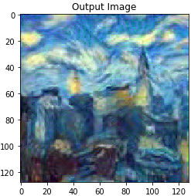
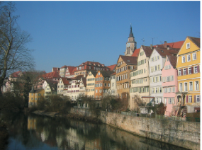
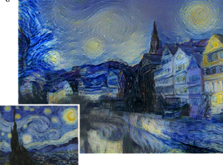
Follow the above method, given a painting (such as Van Gogh's work)
We can extract its style features, and then given a landscape photo (no style)
We can integrate the style features into this landscape photo, This is called Neural Style Transfer.
This is how the picture looks like after using our model

Slide 16
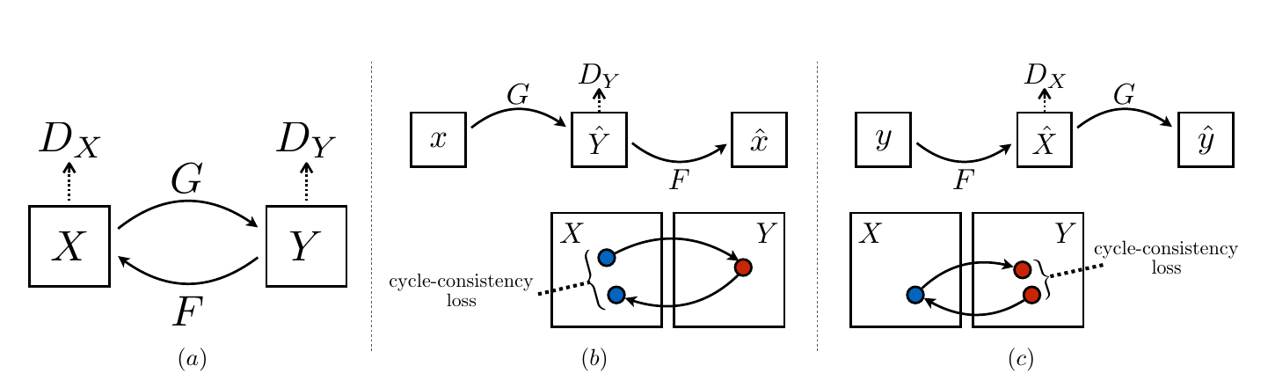
CycleGAN
The CycleGAN is a technique that involves the automatic training of image-to-image translation models without paired examples.

Slide 17
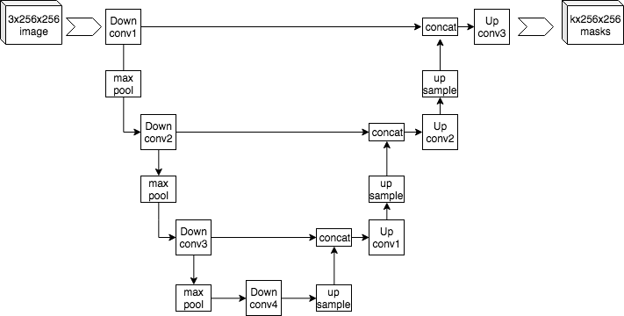
CycleGAN Generator
U-net Generator
A U-Net consists of two halves:
-- Downsampling half, where input images are compressed spatially but expanded channel-wise.
-- Upsampling half, where representations are expanded spatially while the number of channels is reduced.

Slide 18
Cycle Consistency Loss
For input x, we first map it to Y with G(x), and then we map it back with F(G(x)), we expect x~F(G(x)), and similarly we have y~G(F(y)).

Slide 19

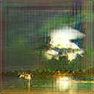

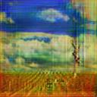

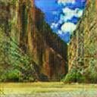
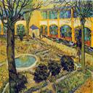
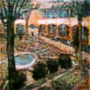

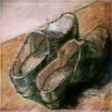
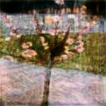
Result

Slide 20
NST & CycleGAN
Differences
Neural Style Transfer is to mix the style of one of Van Gogh's works with another content picture.
CycleGAN learns Van Gogh's Style through several pieces of his works, and then mix it with the content picture.

